Slide 1
Add Title
MSc Defense
Student Name:
Registration No.
Supervisor:

Slide 2
Table of Contents
Introduction/Background
Literature Review
Problem Statement
Significance of Research
Aim and Objectives
Methodology
Results and Discussion
Conclusions
Recommendations (optional)
References

Slide 3
Introduction
Guidelines
The presentation time will be 10mins followed by 3mins Q/A session.
Avoid long paragraphs. Make use of bullet statements.
Figures and graphs should be of good quality and data should be readable.
Use APA Citation Style for in-text citation (https://www.mendeley.com/guides/apa-citation-guide/)
APA in-text citation style uses the author's last name and the year of publication, for example: (Field, 2005).

Slide 4
Literature review
Relevant current research that is close to your topic.
Different theories that may apply to your specific area of research.
Areas of weakness that are currently highlighted.

Slide 5
Problem Statement
Problem statement should be written in one statement with no bullets. Avoid adding figures in this slide. The authors can add figures in the background.

Slide 6
Significance of Research
Compare your work with the work that was done by others and pointing out the things that your study does which was never done before.
It can be a new methodology or a new design that sets the stage for new knowledge.
It could be an approach that purposefully attempts to add more understanding to the current knowledge base.

Slide 7
Aim and Objectives
The aim of the study is ____
Following are the research objectives:
____________
____________
____________

Slide 8
Methodology
Explain the methodology briefly. A great methodology slides explains the what, how, and why.
What method did you use for your research
Why did you choose it
How did you conduct it
The most effective way to aid understanding is by using graphics like flowcharts and tables.

Slide 9
Table format:
Table 1: Title of the table

Slide 10
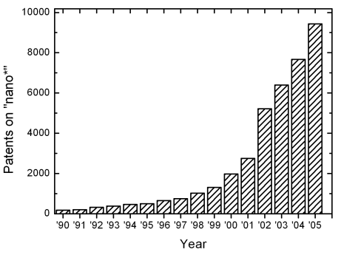
Figure format:
Figure 1: Title of the figure

Slide 11
Results and Discussion
This chapter present the findings and outcomes of research and reason for that particular results in the form of text, figures graphics and charts.
Results
Tells us about outcomes/ findings of the research study.
Present the data ad findings, ordered/analyzed in ways justified earlier (methodology)
Usually, past tense is feature here.
Describes the findings in a simple way with the help of data.
Figures and tables appear here.

Slide 12
Results and Discussion
Discussion
What does the result or data from the experiment mean to us is described in discussion.
Function of discussion is to:
Interpret results in a light of what was already known about the subject and
Explain new understanding of the problem after taking results into consideration.
Explain how the results answer the questions under study.

Slide 13
Conclusions
The conclusion should be short and concise. It should summarize or highlight the main points you made or emphasize what the audience should have learned. Do not restate everything you said in the body and never introduce new information at this time.
Conclusion can be written in paragraph / point form.

Slide 14
Recommendations
It suggests action to be taken based on findings.
It is related to conclusion.
Recommendation can be written in paragraph / point form.

Slide 15
References
Use APA Reference style:
Derwing, T. M., Rossiter, M. J., & Munro, M. J. (2002). Teaching native speakers to listen to foreign-accented speech. Journal of Multilingual and Multicultural Development, 23(4), 245-259.
Krech Thomas, H. (2004). Training strategies for improving listeners' comprehension of foreign-accented speech (Doctoral dissertation). University of Colorado, Boulder.

